Slide 1
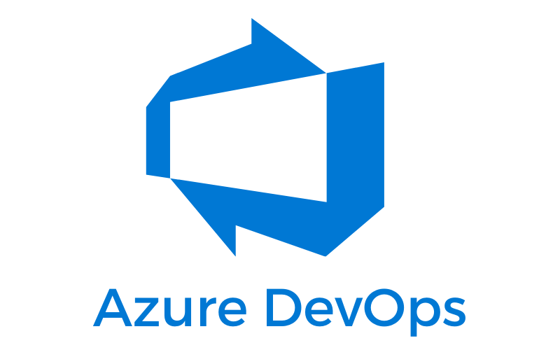
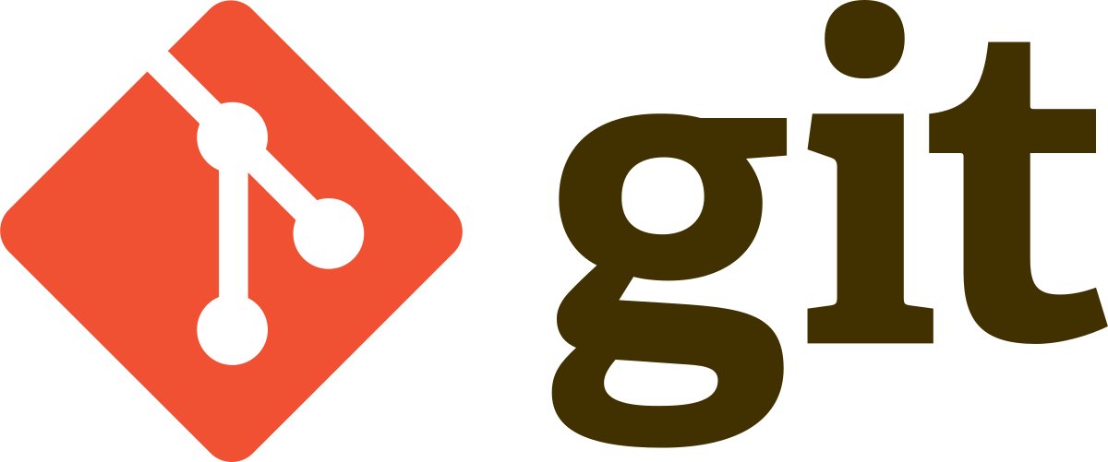
Git and Azure DevOps

Slide 2
What is Git?
Git is free and open source, distributed version control system designed by Linus Torvalds (the creator of Linux) to handle everything, from small to very large projects. It stores the history of our project in the form of snapshots called commits.
It is the most used version control system in the world currently.
Git can be accessed via command line or through desktop GUI client as: TortoiseGit, GitKraken, Fork and others.
Online hosts as GitHub and BitBucket can be used for storing of copy of the Git repository, enabling smoother collaboration with other developers.

Slide 3
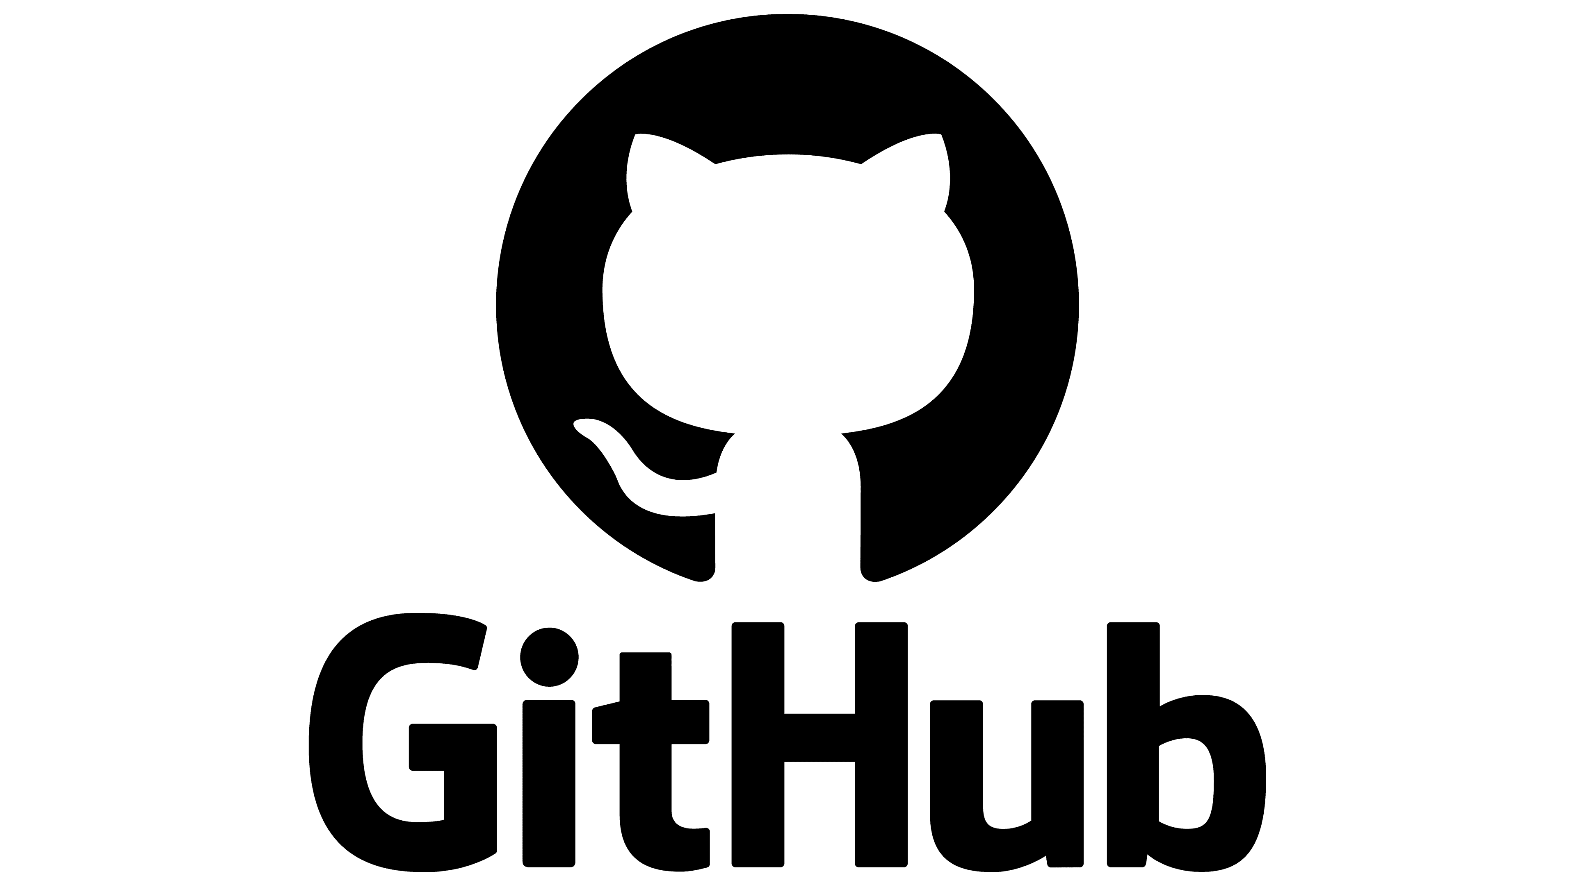
Git is NOT the same as GitHub
Git is the software itself, designed to be used with different commands for managing of projects and their versions. This software tracks our changes in the project.
GitHub is a web host (website) in which we can store our repositories. Git software runs in GitHub.
We can use Git without GitHub, but we cannot use GitHub without Git.
is NOT

Slide 4
Git commands (console)
git init - initializes a new git repo locally
git add - is used for staging of all changes that we want to be part of our next commit
git commit - creates commit which in general speaking means a snapshot of our repository for the certain moment.
git push - sends our local work (all commits) to the remote central copy of our repository which is placed in GitHub, Azure DevOps or elsewhere
git pull - get all new work from the remote central repository that is not in our local repository
git merge - merges the work from two branches.
git checkout – switch to another branch (there is switch command as well)

Slide 5
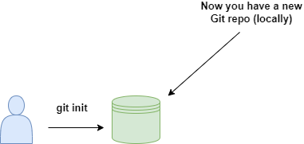
git init
git init - initializes a new git repository locally

Slide 6
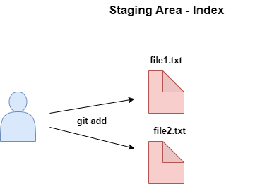
git add
git add - is used for staging of all changes that we want to be part of our next commit

Slide 7
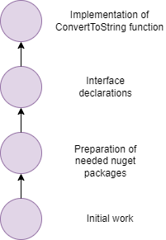
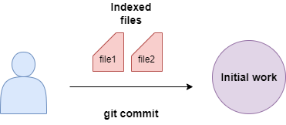
git commit
Commits

Slide 8
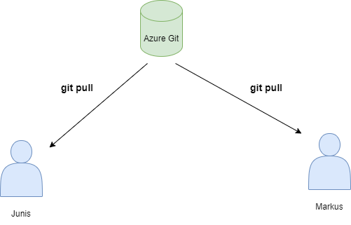
git pull
git pull - get all new work from the remote central repository that is not in our local repository

Slide 9

What is a branch in Git?
A branch represents an independent line of development.
In Git a branch is a pointer to specific commit
It is fundamental feature of Git and is absolutely crucial for developing phase.
Whit branches, many people may work on different features and can merge after that their work into the main branch.

Slide 10
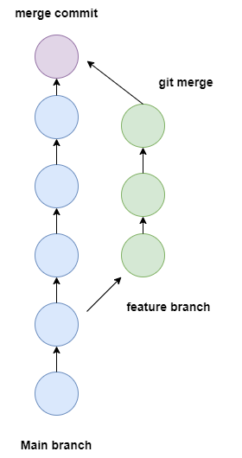
git merge
git merge - merges the work from two branches.

Slide 11
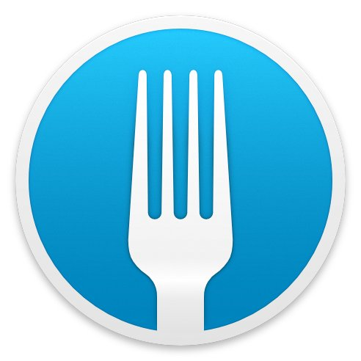
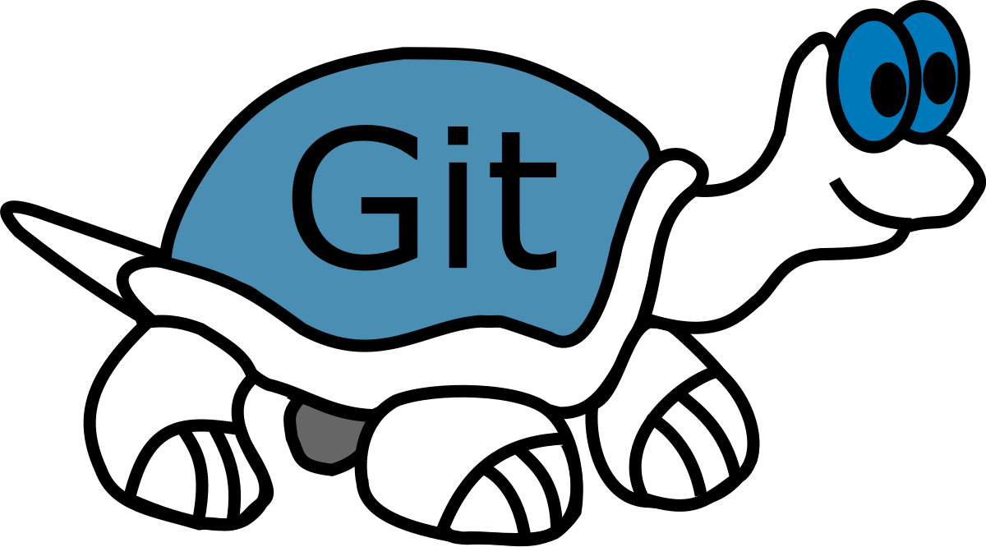
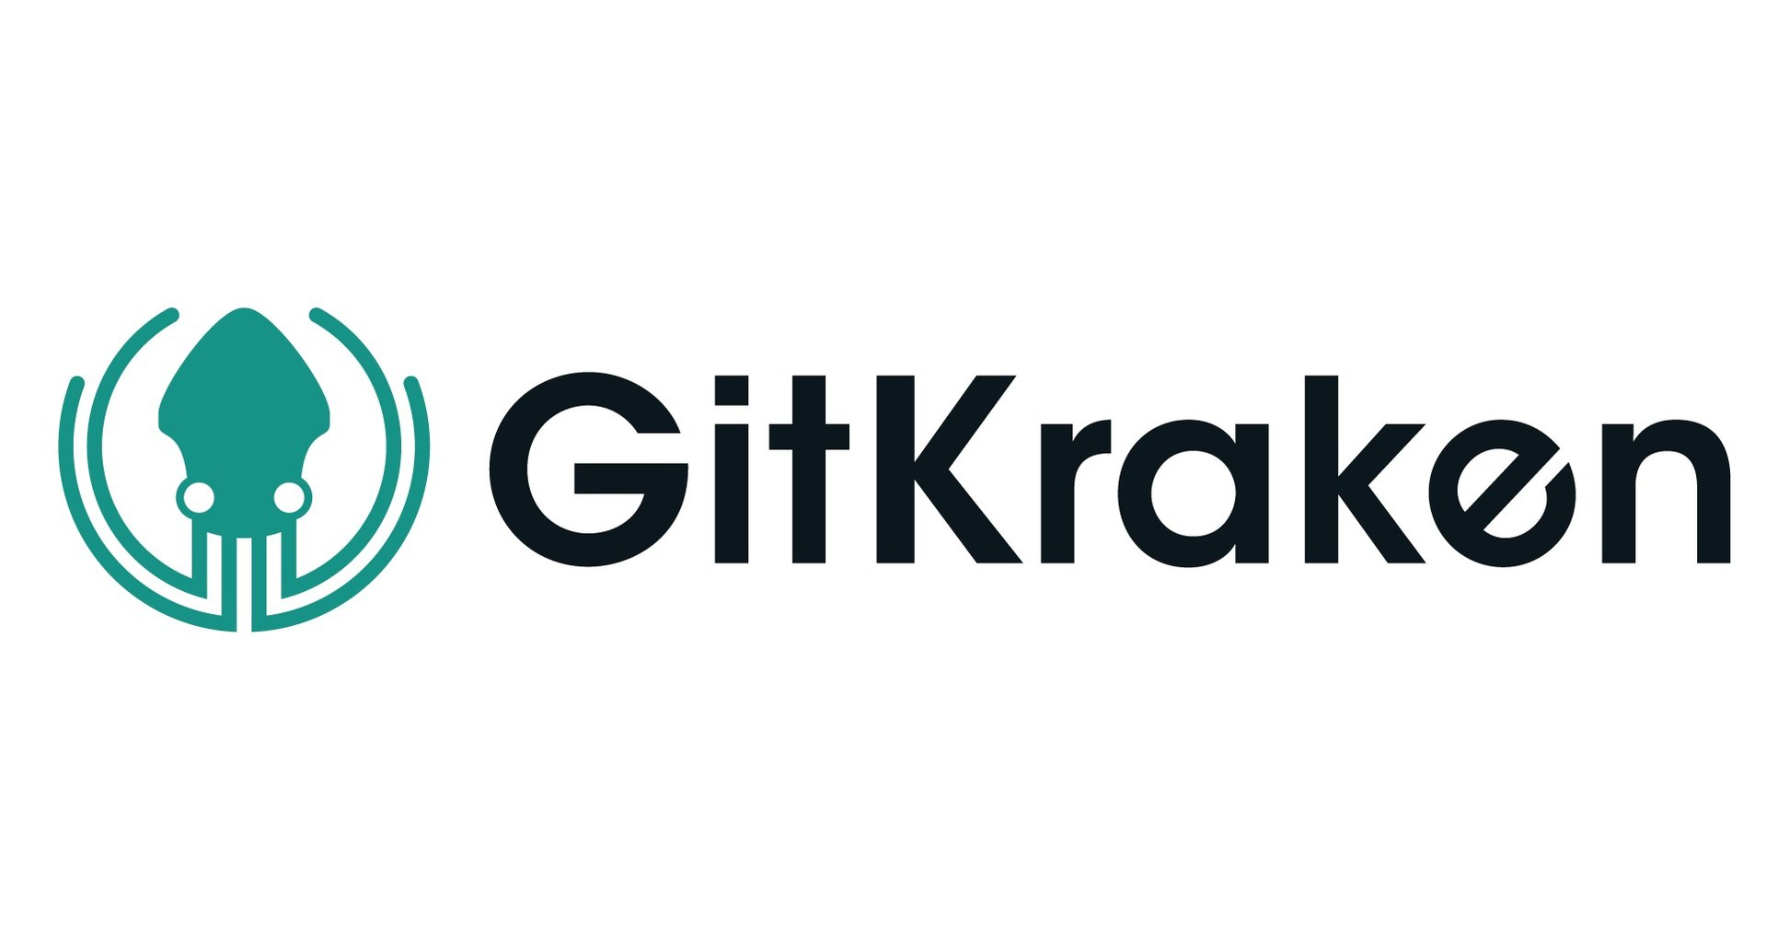
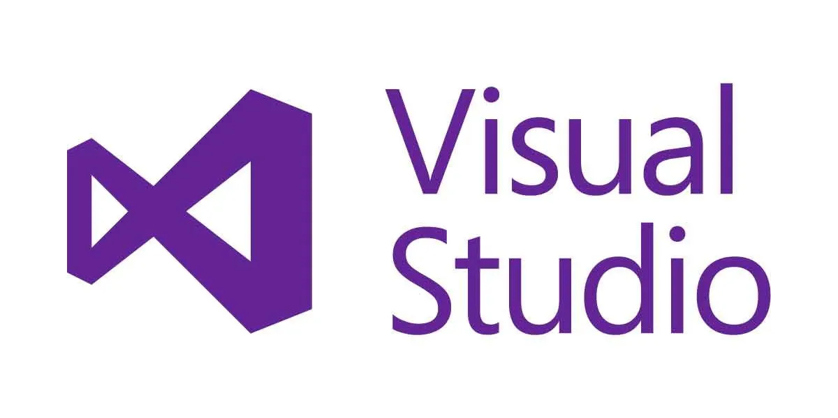
Git GUI clients
Fork
Tortoise Git

Slide 12
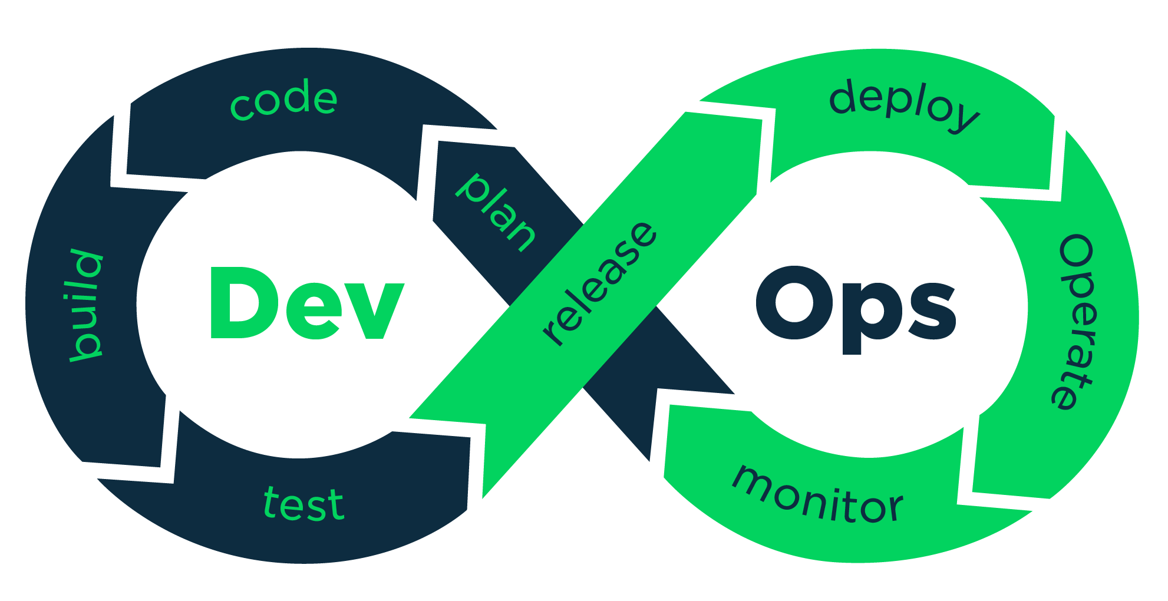
What is DevOps?
DevOps (from “development” and “operations”) is the combination of practices and tools designed to increase an organization’s ability to deliver applications and services faster than traditional software development processes.
DevOps is a philosophy that promotes better communication and collaboration between Development and Operation teams.

Slide 13

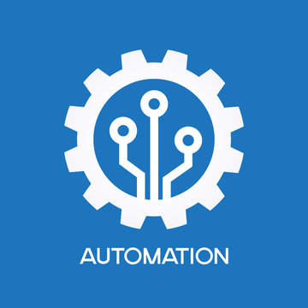
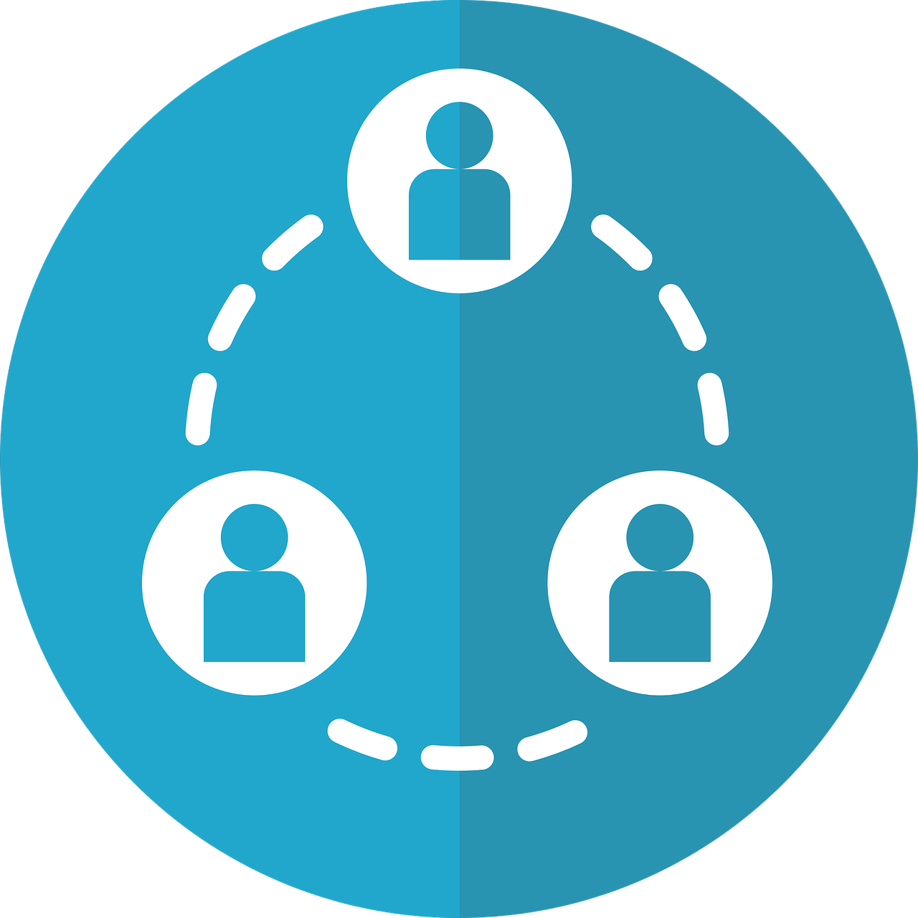

Core DevOps principles
Communication
Collaboration
Automation
Monitoring
monitoring
automating
collaborating
communicating

Slide 14

DevOps benefits
More automation
Rapid delivery
Improved collaboration
More responsive to business needs
Shorter time to market
Better quality
More frequent releases
DevOps = New mindset + New tools + New skills

Slide 15
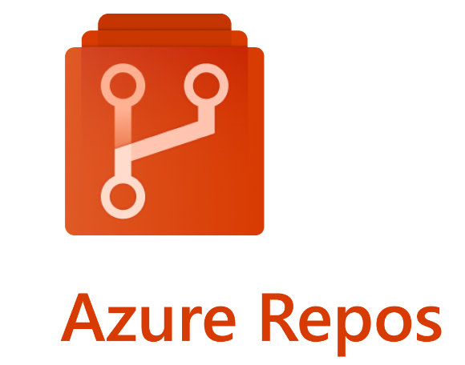
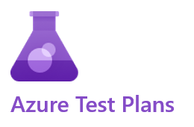
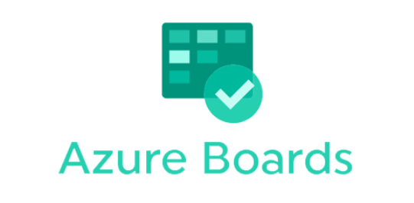
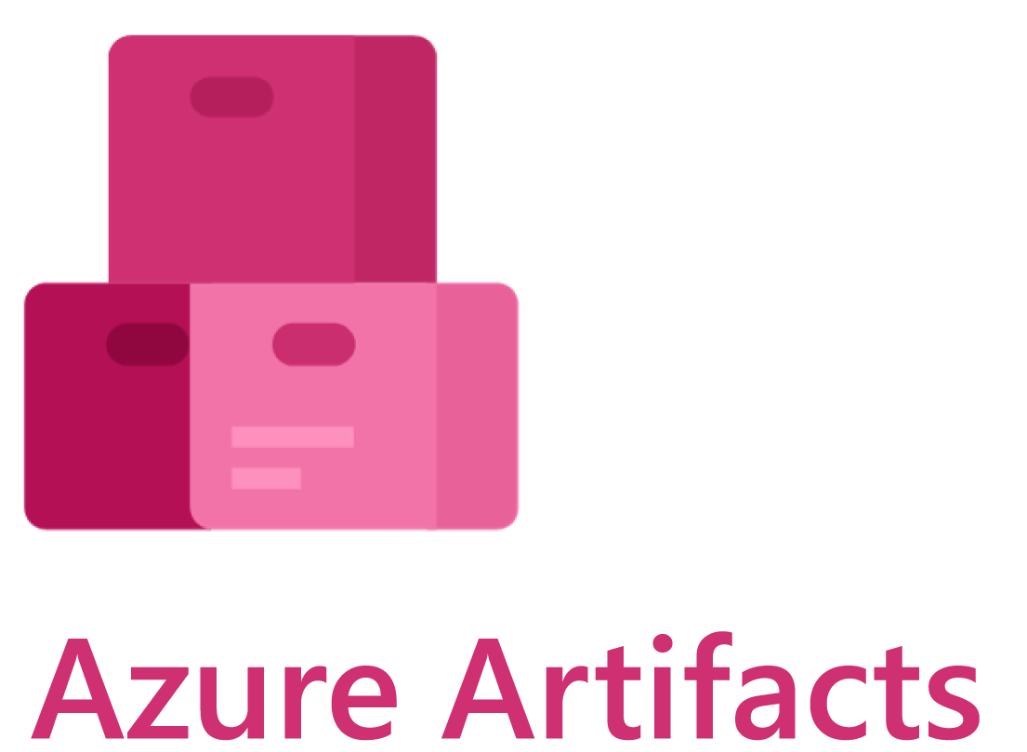
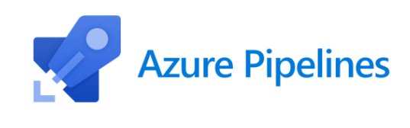
What is Azure DevOps?
Azure DevOps is a set of tools and services provided by Microsoft for managing of software projects. It is Software as a Service (SaaS) and it is platform for implementing of all DevOps processes.
Core Azure Services: Azure Boards, Azure Repos, Azure Pipelines, Azure Test Plans, Azure Artifacts

Slide 16
Azure Boards
Azure Boards is a work tracking system that is part of the Azure DevOps suite of development tools. It helps teams to plan, track and discuss work across the development cycle.
With Azure Boards, teams can create and prioritize work, items, track progress and status, and stay updated with real-time dashboards and reports.

Slide 17
Azure Repos
Azure Repos is a version control system that is part from Azure DevOps. It helps teams to track and manage the changes in their code, while also provide tools for collaborating on and reviewing.
With Azure DevOps teams can work with Git or With TFVC (Team Foundation Version Control)
In our team we use Git for version control system.

Slide 18
Azure Pipelines
Azure Pipelines is a continuous integration and continuous delivery (CI/CD) platform that helps developers to automate the build, test and deploy their code.
With Azure Pipelines, developers can create automated workflows to build, test and deploy their application to variety of platforms.
Azure Pipelines have a good integration with Git repositories, Docker containers, and many programming languages which helps to developers a lot in their needs.

Slide 19
Azure Test Plans
Azure Test Plans is a testing tool that is part of the Azure DevOps. It helps teams plan, track, and manage their testing efforts, including manual and automated testing.
With Azure Test Plans, teams can create and organize test cases, track test results and progress, and report on test coverage.

Slide 20
Azure Artifacts
Azure Artifacts is a package management service that is part of Azure DevOps. It helps teams manage and share software packages, including libraries, frameworks, and other dependencies.
With Azure Artifacts, teams can create, host, and share their own packages, as well as consume packages from other sources.

